Slide 1
Towards an official CTF Team of CSU
Vitamin G

Slide 2
About US
We are wannabe hackers...
The “G” is for Gersch, Dr. Gersch.
Current members -
CEO and founder - Saptarshi Chatterjee - OG
Diptendu Kar - 0x0FF537
Subhojeet Mukherjee - j4l_$h0vn
Captain - Jordan Peterson - AirJordan

Slide 3
What is a CTF?
It is a game. (cybersecurity competition)
A TEAM game.
Requirements –
Team.
Skills.
Strategies.
Same mentality.

Slide 4
What’s in it for you?
Money $$
CyberSeed 2019 winners - $15,000 – 4 members.
Swag
Defcon badges, t-shirts etc.
Resume
Jobs
Learning new skills.

Slide 5
CTF Types and Categories
Cyber Skyline
NCL and CyberSeed
Categories
OSINT
Crypto
Password Cracking
Log Analysis
Network Traffic Analysis
Web Application Exploitation
Software Security – Reverse Engineering.

Slide 6
CTF Types and Categories
All others NOT Cyber Skyline
Defcon, Google CTF, RITSEC, TUCTF …..
Categories
Crypto
Reverse Engineering
Pwning – Shell code buffer overflow
Web
Misc. – Steganography, programming, Machine Learning (some)
Forensics

Slide 7
Our skills (we think so) and strategy
Skills we think we have
Saptarshi – Steganography, OSINT, Forensics
Diptendu – Crypto, Steganography, Web (a bit)
Subhojeet – Reversing and Pwning
Jordan – Networking, Password cracking, OSINT
Strategy
Divide and conquer
Try to solve challenges in respective area
If all challenges are done OR challenge too difficult, move to other category
Help others – coding, brainstorming

Slide 8
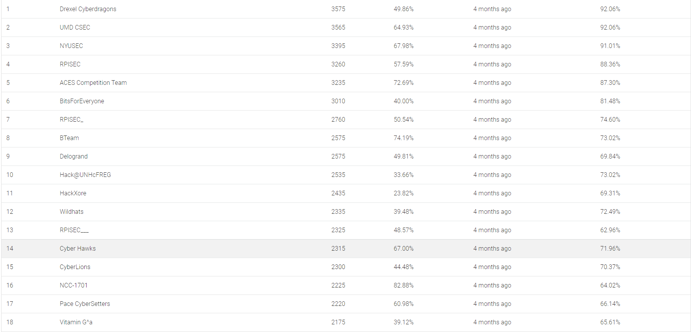
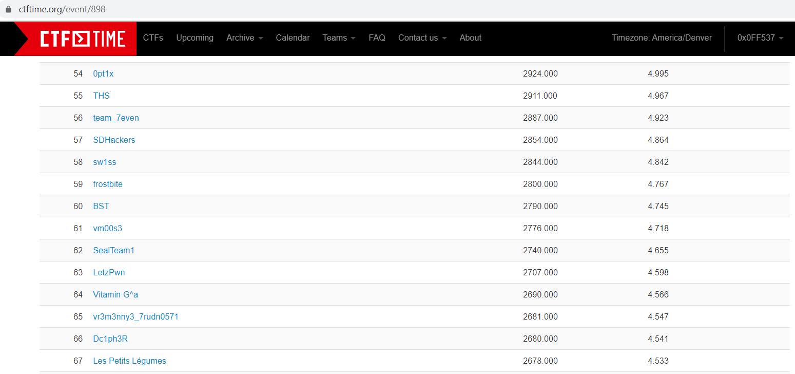
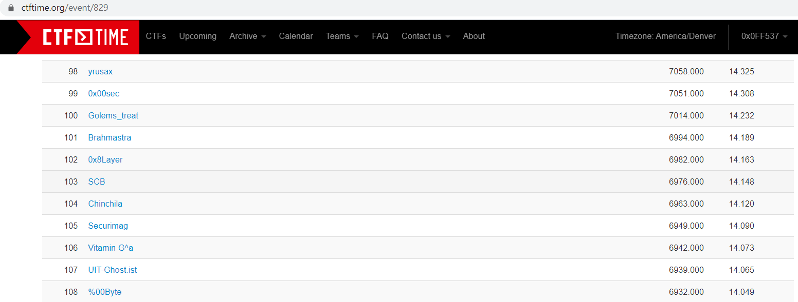
Our journey so far
CyberBioSecurity Hackathon – 3rd. First place – Kryptsec.
CyberSeed 2019 – 18 / 57.
RITSEC – 64 / 900. Kryptsec – 176 / 900
TUCTF – 106 / 1005.
HACKTM CTF QUALS – one challenge
NullCON – one challenge

Slide 9
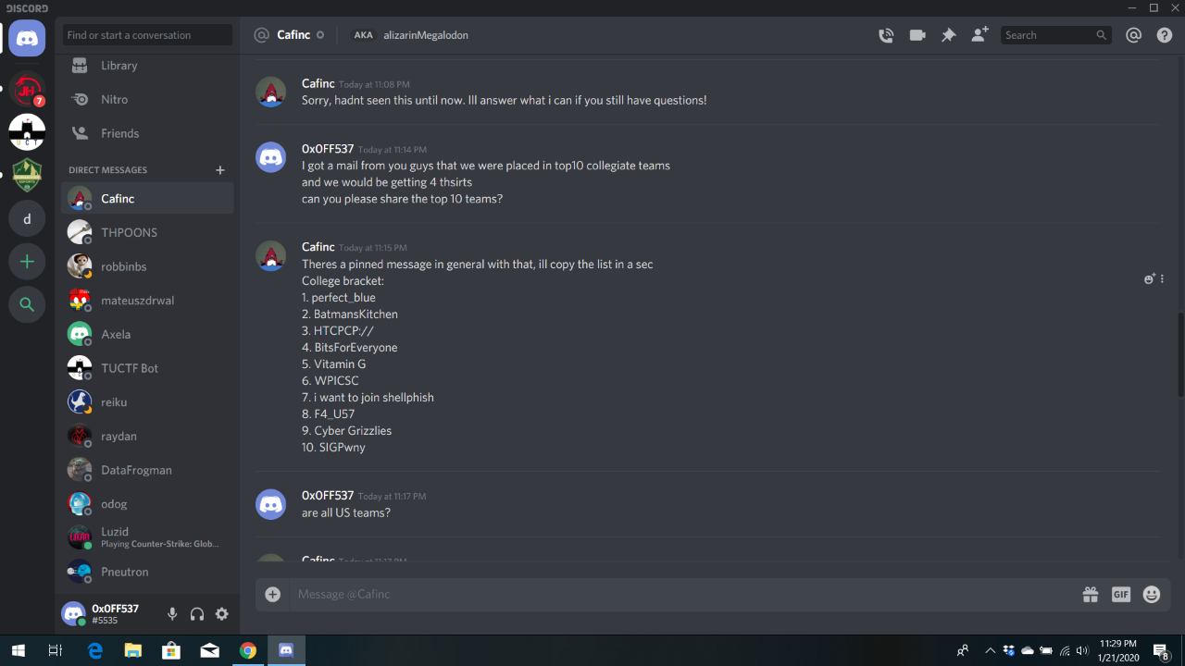
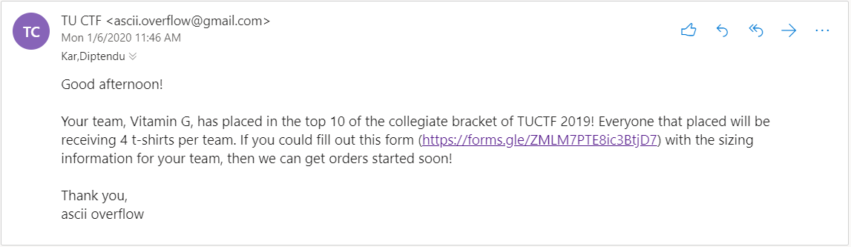
And then…

Slide 10
Other teams
Perfect_blue - MIT, UMD + others - 12 members
Batman’s Kitchen - University of Washington - 13 members
BitsForEveryone - United States Military Academy (West Point) - 28 members
WPICSC - Worcester Polytechnic Institute - 8 members
Cyber Grizzlies - Cornell -7 members
SIGPwny - University of Illinois at Urbana-Champaign - 6 members
us – 4 members (revised to 3)

Slide 11
Enough talk… Lets see some challenges

Slide 12
Crypto

Slide 13
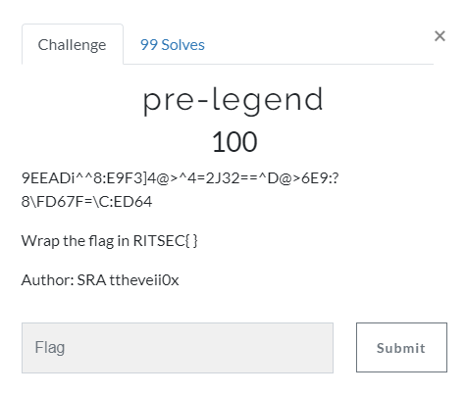

Slide 14
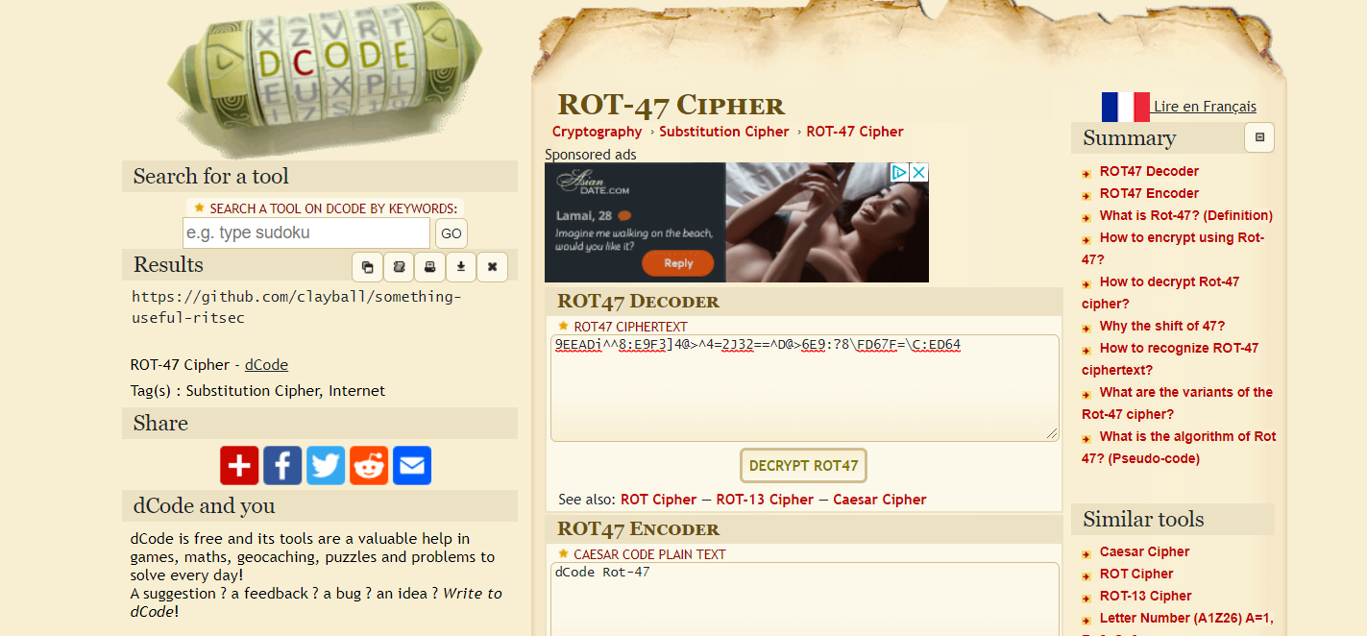
RITSEC {https: //github.com/clayball/something-useful-ritsec}

Slide 15
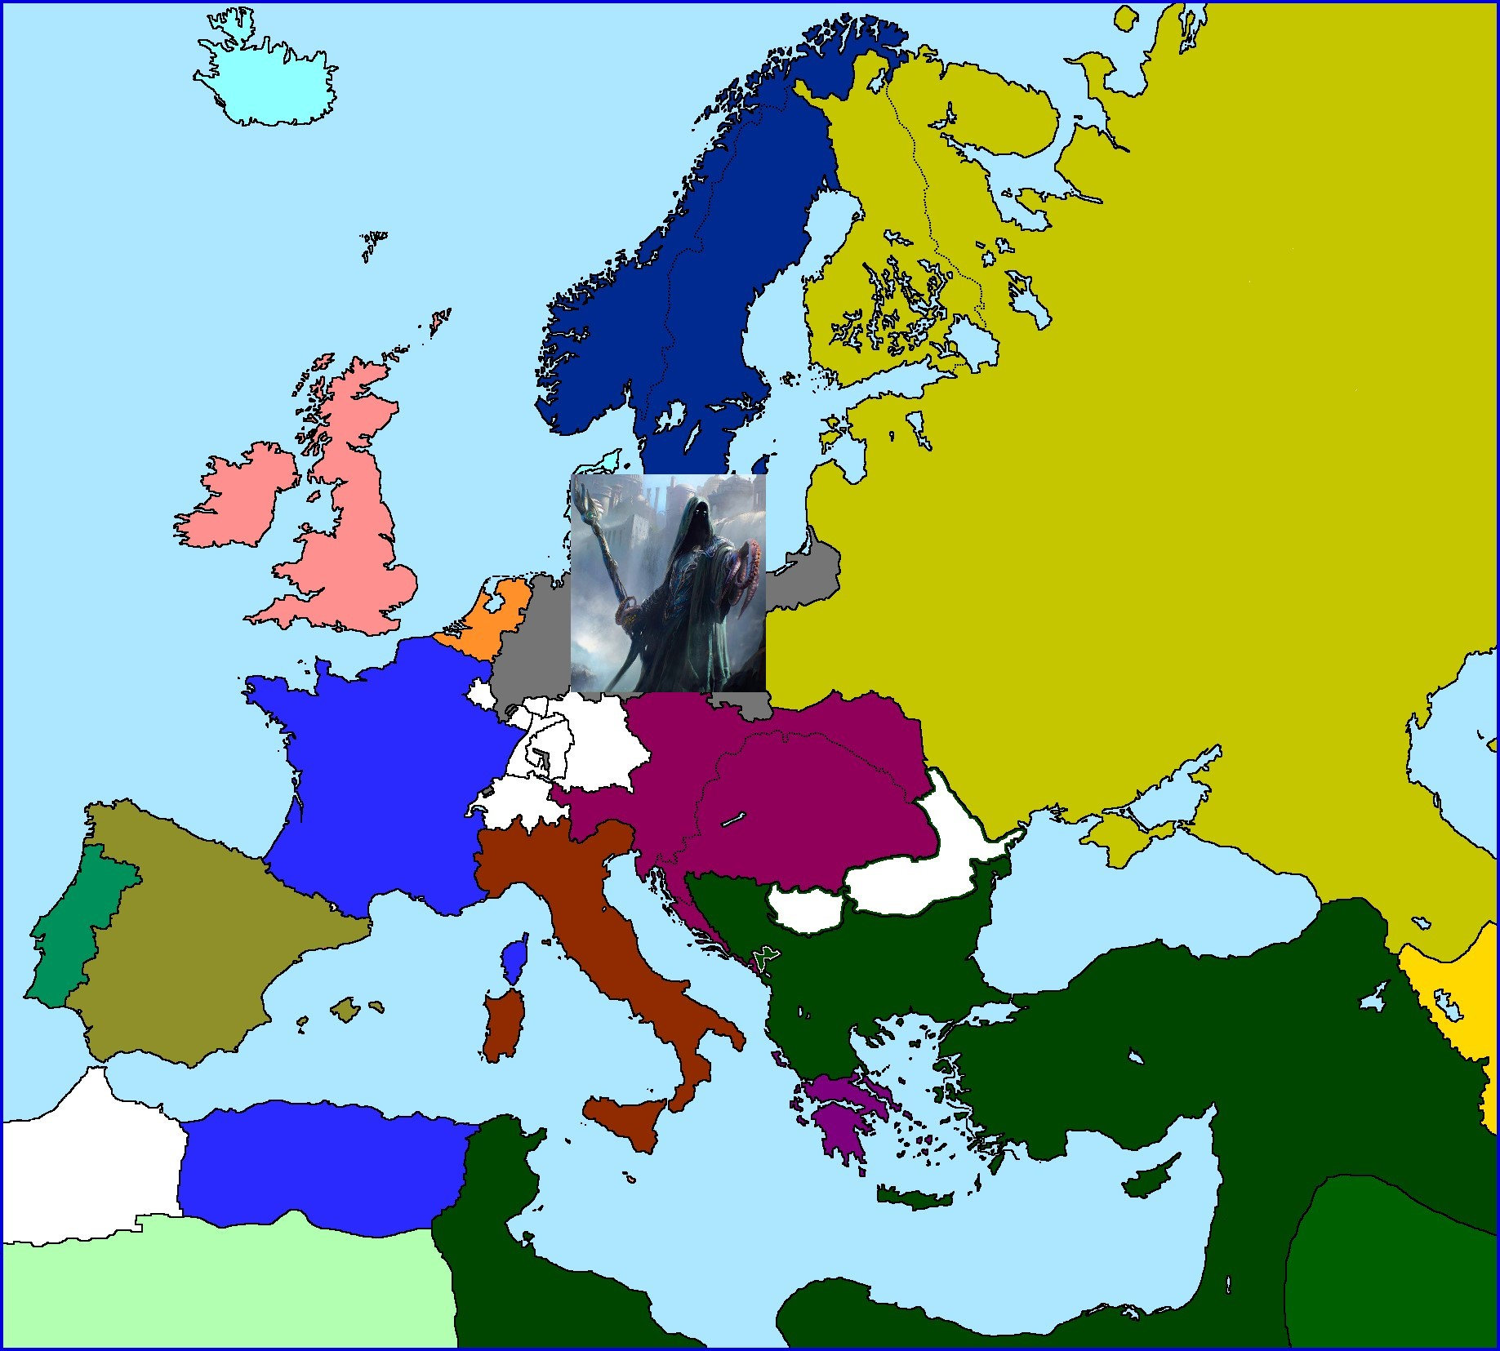
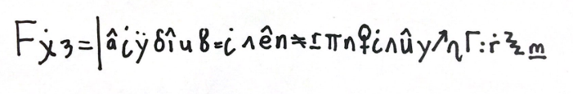

Slide 16
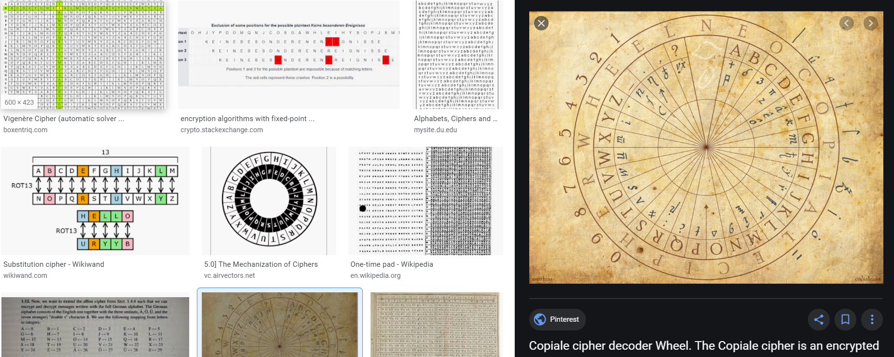

Slide 17
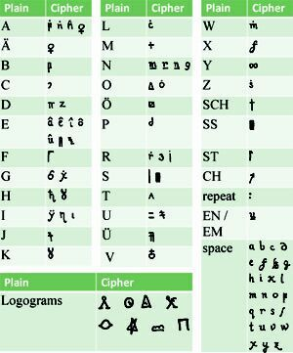
FGRUSELIGE KULTE UND ALTE?CH?F repeat REN
Google Translate
RITSEC{CREEPY CULT AND OLD CIPHERS}

Slide 18
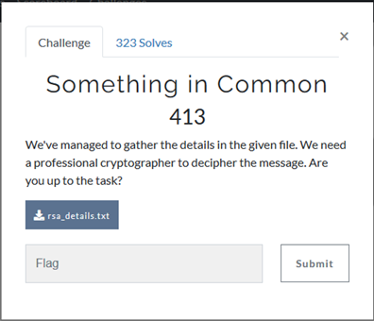

Slide 19
n = 5196832088920565976847626600109930685983685377698793940303688567224093844213838345196177721067370218315332090523532228920532139397652718602647376176214689 e1 = 15 e2 = 13 c1 = 2042084937526293083328581576825435106672034183860987592520636048680382212041801675344422421233222921527377650749831658168085014081281116990629250092000069 c2 = 199621218068987060560259773620211396108271911964032609729865342591708524675430090445150449567825472793342358513366241310112450278540477486174011171344408

Slide 20
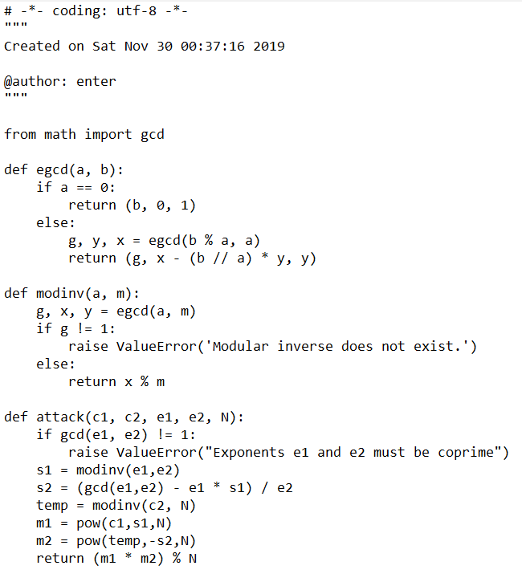

Slide 21
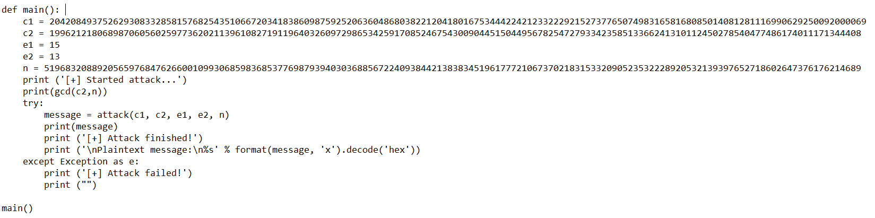
TUCTF{Y0U_SH0ULDNT_R3US3_TH3_M0DULUS}

Slide 22
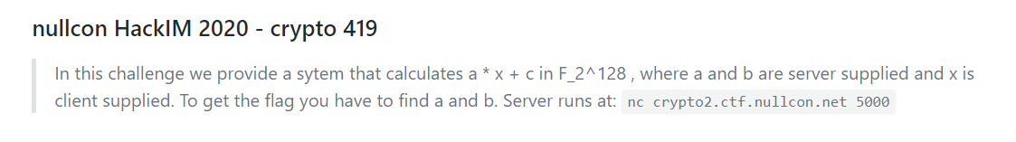

Slide 23
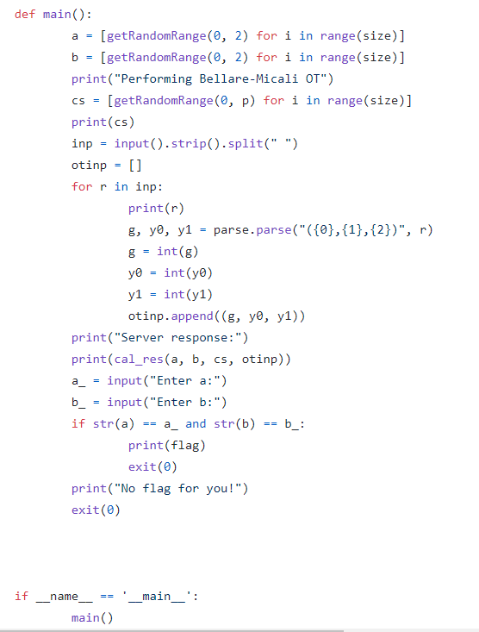
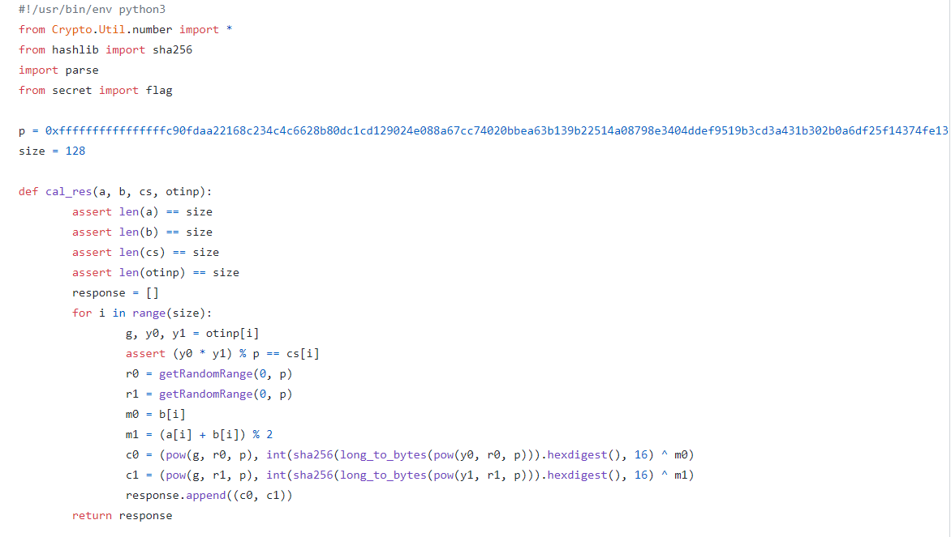

Slide 24
Web

Slide 25
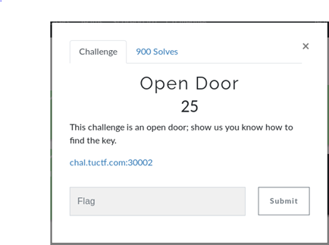
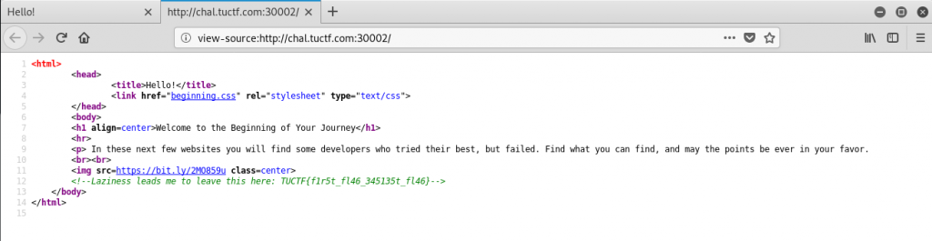

Slide 26
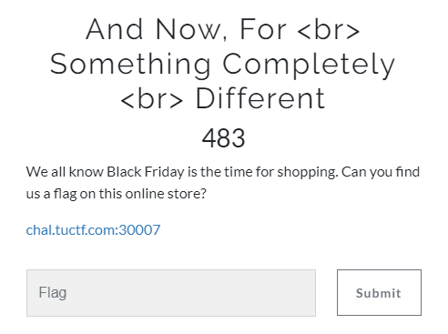

Slide 27
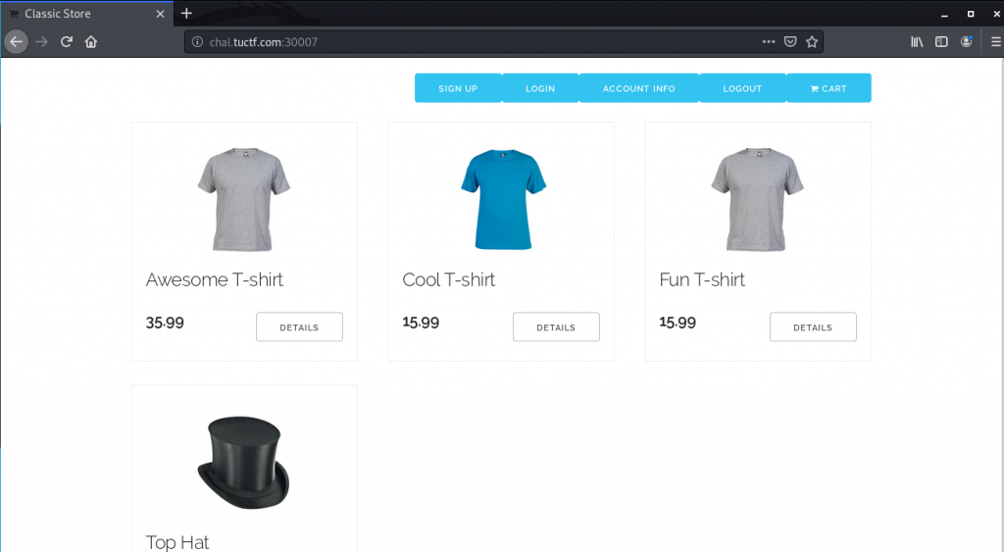

Slide 28
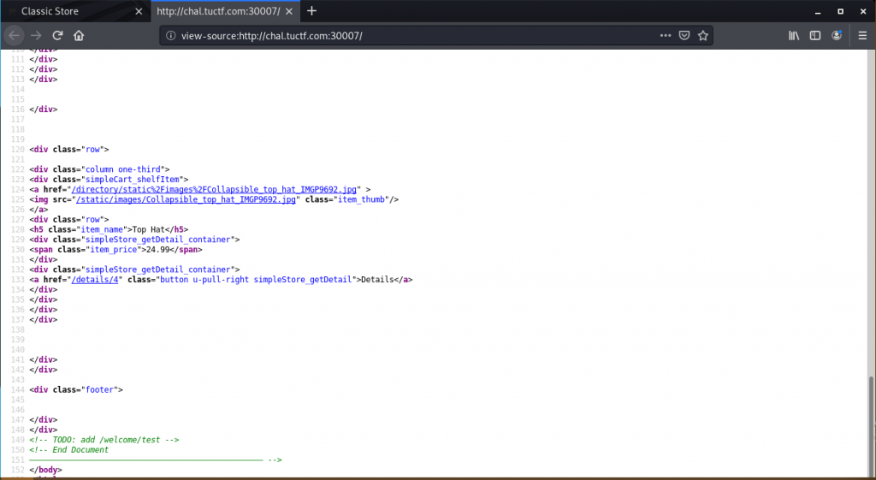

Slide 29
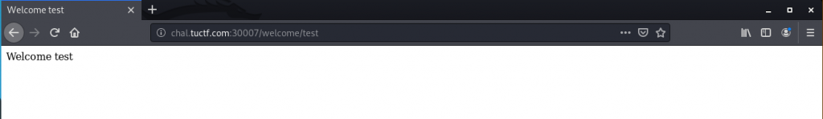
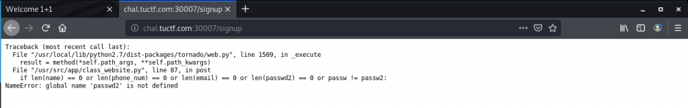
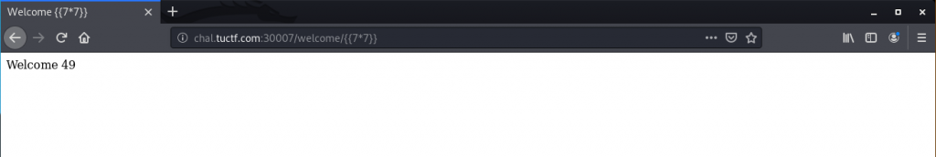

Slide 30
{%import os%}{{os.popen(« cat ./flag.txt »).read()}} Add url encoding to it and access the webpage: %7B%import%20os%%7D%7B%7Bos.popen(%22cat%20.%2Fflag.txt%22).read()%7D%7D Full url: http://chal.tuctf.com:30007/welcome/%7B%import%20os%%7D%7B%7Bos.popen(%22cat%20.%2Fflag.txt%22).read()%7D%7D

Slide 31
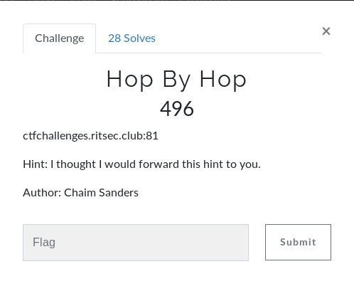

Slide 32
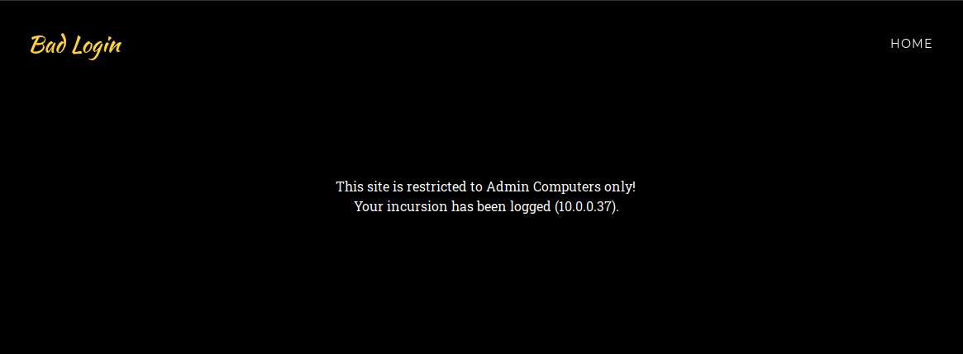

Slide 33
Misc.

Slide 34
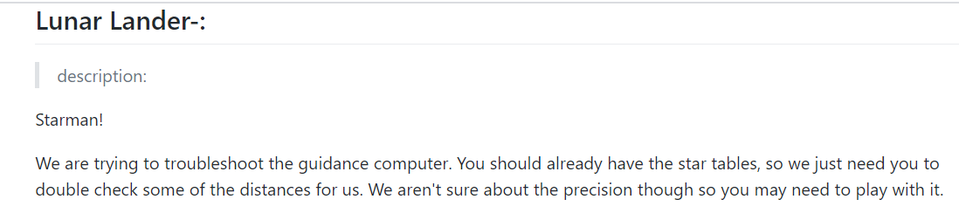

Slide 35
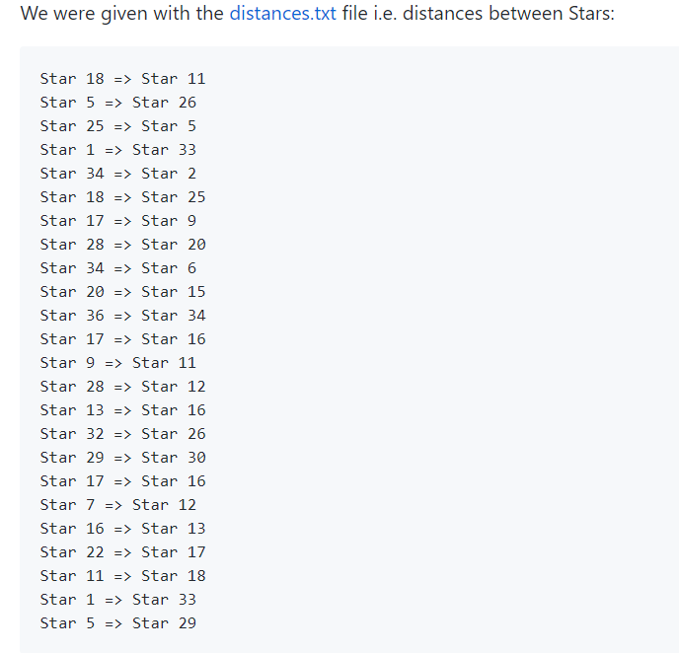
HINT
If you lost your copy of 'STAR TABLES', you should be able to find the 'open source' version

Slide 36
x = [18, 5, 25, 1, 34, 18, 17, 28, 34, 20, 36, 17, 9, 28, 13, 32, 29, 17, 7, 16, 22, 11, 1, 5]
y = [11, 26, 5, 33, 2, 25, 9, 20, 6, 15, 34, 16, 11, 12, 16, 26, 30, 16, 12, 13, 17, 18, 33, 29]
Land the lunar lander safely using the Star_tables out there.
Apollo-11/STAR_TABLES.agc at master · chrislgarry/Apollo-11
Write python code calculate Euclidean Distance for the points above, giving us the flag.
ritsec{leap_4_th3_stars}

Slide 37
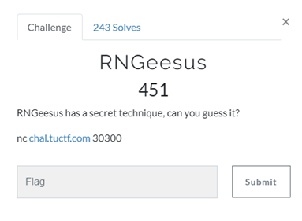

Slide 38
The only hint we got here is that there is a standard rand function that we had to use in order to generate a number from a given seed.
https://opensource.apple.com/source/Libc/Libc-1044.1.2/stdlib/FreeBSD/rand.c
Had to modify this code to input the given seed and generate random numbers to provide the next seed.
This would be done a few times after which we would get the flag.

Slide 39
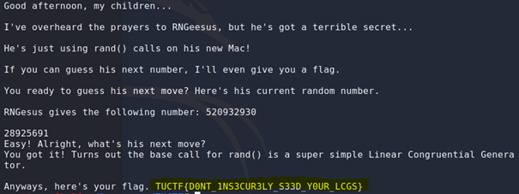

Slide 40
On chal.tuctf.com:30102 a server presents the audacious with a 10-level challenge (level 0 ~ level 9).
There is no "save" functionality. Therefore, each try always starts from level 0.

Slide 41
Here we played a game with a server they were running. We would give a text, and its encoding would be available to us, along with the next encoding to solve.
We tried manually first and decided to get the encoding of “ABCDEFGHIJKLMNOPQRSTUVWXYZ”
We received an encoding response of [ '_|', '|_|', '|_', ']', '[]', '[', '-|', '|-|', '|-', '._|', '|._|', '|._', '.]', '[.]', '[.', '.-|', '|.-|', '|.-', 'v', '>', '<', '^', '.v', '.>', '.<', '.^' ]
After this we automate this by writing a simple socket program in python in order to play question and answer, because the response time of your decoding is vital.

Slide 42
Networking

Slide 43
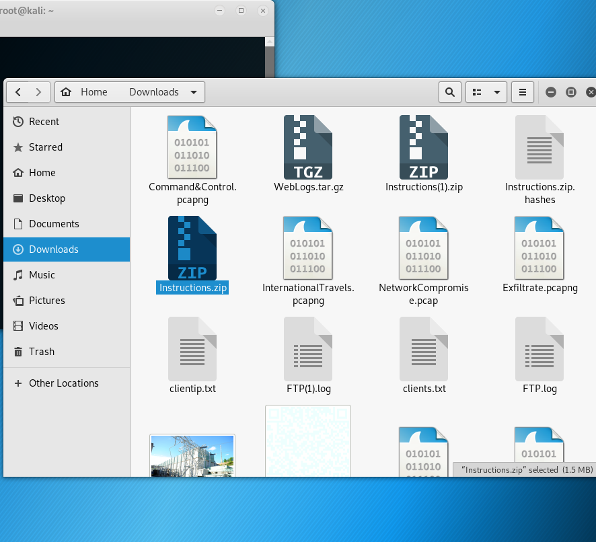
Misc: breaking zip file encryption

Slide 44
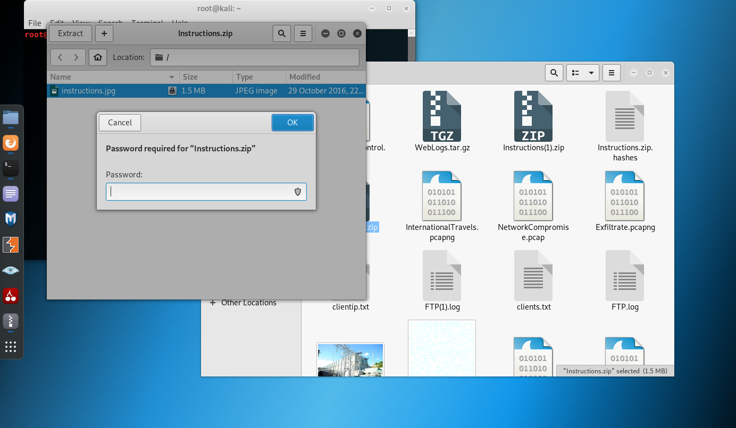

Slide 45
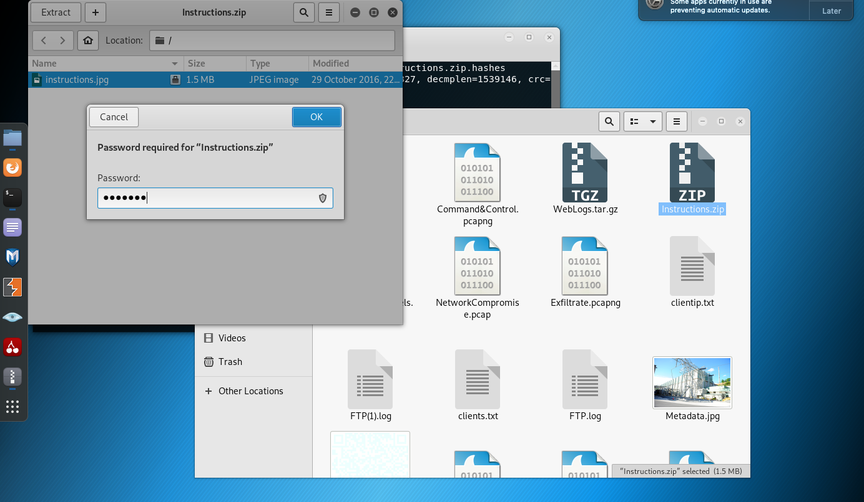

Slide 46
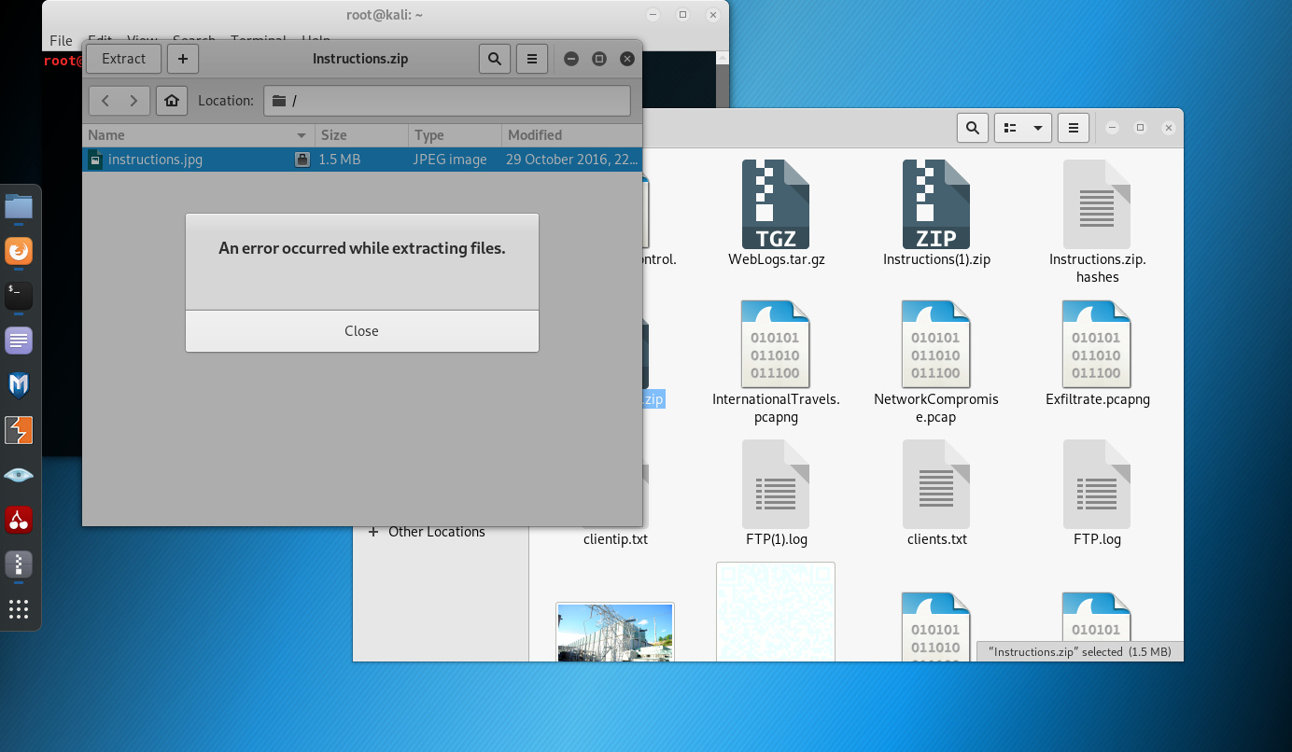

Slide 47
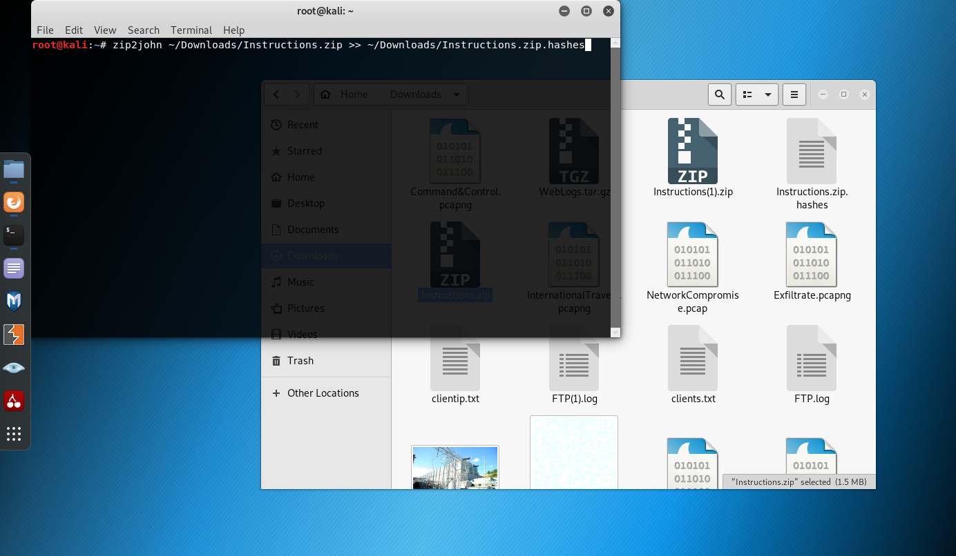

Slide 48
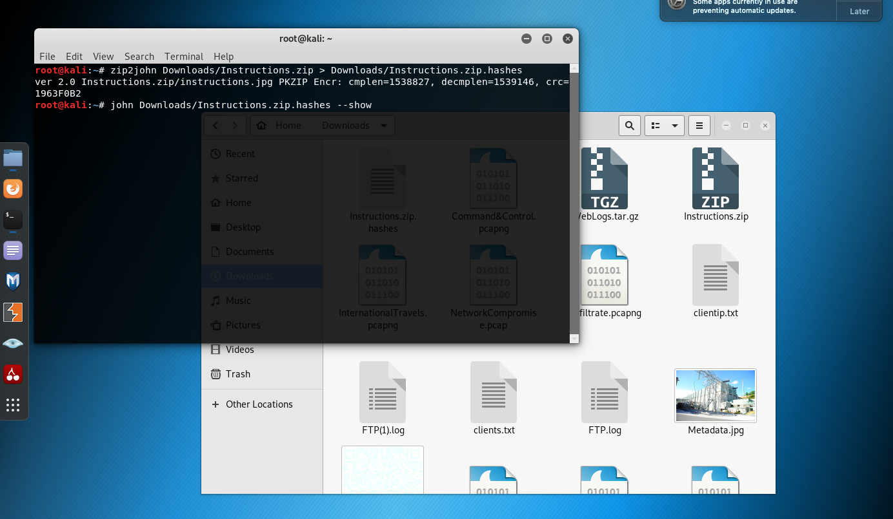

Slide 49
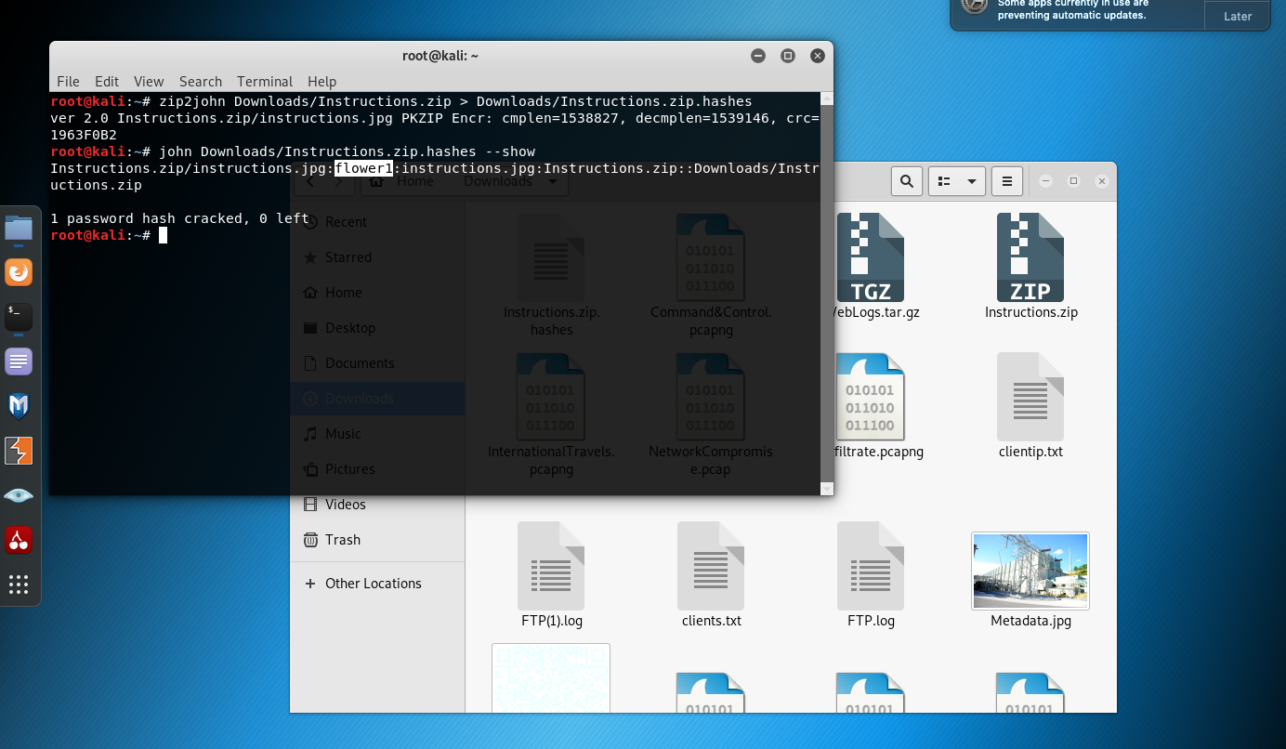

Slide 50
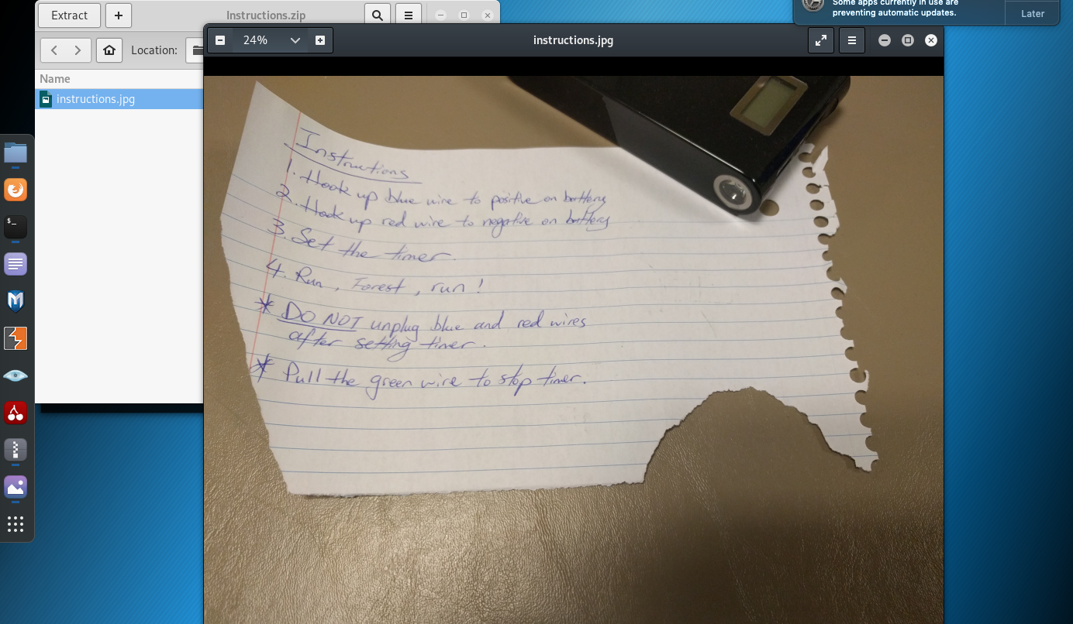

Slide 51
Get the pcap
https://github.com/Jordan-Peterson/CTF_PCAPS

Slide 52
I wonder what my hotel neighbor is doing…
FOILED by WEP again, guess we give up right?
Aircrack-ng can help
WEP is pretty outdated
Bad key management
Small key size
Much more http://www.opus1.com/www/whitepapers/whatswrongwithwep.pdf

Slide 53
Challenge
Now that we can see the IP packets, lets see what we can find:
1. Find out what IP: 192.168.0.100 was searching for
2. How many protocols are in the capture?
3. What relative time did the ARP spoof start
4. What attack uses this ARP spoof technique

Slide 54
Congrats

Slide 55
Reversing - Live

Slide 56
Join US
If you like doing these stuff - join us.
Do not compromise your own studies for this.
You do not need to be an expert. We are all in learning phase.
Target – 2 members for each category. Priorities – WEB.
If you join – SHOW UP.
Next events – NCL, CyberSeed 2020 and others.

Slide 57
Mail: vitaming@cs.colostate.edu
MANY THANKS – TEAM VITAMIN G

Slide 58


